Slide 1
CS 4476/6476 Spring 2020
PS1
Jinghong Peng
jpeng78@gatech.edu
903568613

Slide 2
Short answer problems

Slide 3
1.1 Use numpy.random.rand to return the roll of a six-sided die over N trials.
def prob_1_1(N):
"""
Args: N: the number of trials.
Returns: arr: array of rolls.
"""
### START CODE HERE ###
arr = numpy.random.rand(N)
arr = arr * 6
arr = np.ceil(arr)
### END CODE HERE ###
return arr
1.2 Let y be the vector: y = np.array([11, 22, 33, 44, 55, 66]). Use the reshape command to form a new matrix z that looks like this: [[11,22],[33,44],[55,66]]
def prob_1_2(y):
"""
Args: y: numpy array.
Returns: z: numpy array of shape (new_size,2).
"""
### START CODE HERE ###
z = y.reshape(3, 2)
### END CODE HERE ###
return z

Slide 4
1.3 Use the numpy.max and numpy.where functions to set x to the maximum value that occurs in z (above), and set r to the row number (0-indexed) it occurs in and c to the column number (0-indexed) it occurs in.
def prob_1_3(z):
"""
Args: z: numpy array of shape (3,2).
Returns: x: max value in z.
r: row index of x.
c: column index of x.
"""
### START CODE HERE ###
x = numpy.max(z)
temp = numpy.where(z == x)
r = temp[0]
c = temp[1]
### END CODE HERE ###
return (x, r, c)
1.4 Let v be the vector: v = np.array([1, 4, 7, 1, 2, 6, 8, 1, 9]). Set a new variable x to be the number of 1’s in the vector v.
def prob_1_4(v):
"""
Args: v: numpy array.
Returns: x: number of 1’s in v.
"""
### START CODE HERE ###
x = numpy.count_nonzero(v == 1)
### END CODE HERE ###
return x

Slide 5
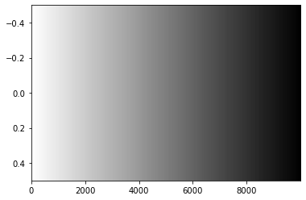
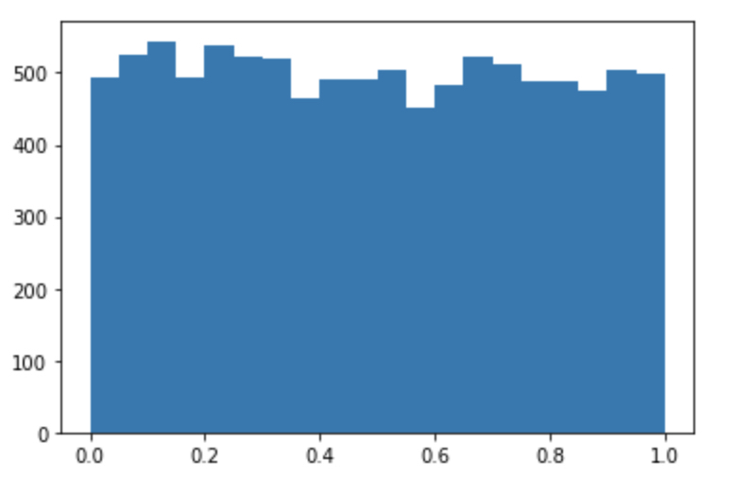
2.1 Plot all the intensities in A, sorted in decreasing value. Provide the plot in your answer sheet. (Note, in this case we don’t care about the 2D structure of A, we only want to sort the list of all intensities.)
<Insert plot here>
2.2 Display a histogram of A’s intensities with 20 bins. Again, we do not care about the 2D structure. Provide the histogram in your answer sheet.
<Insert plot here>

Slide 6
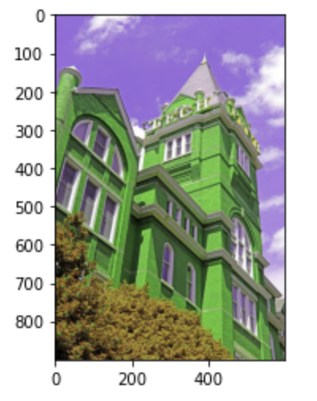
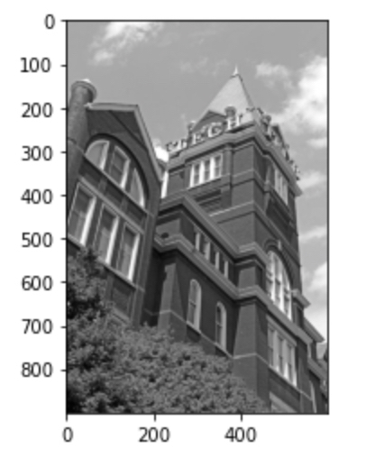
3.1 Display the color channel swapped image.
<Insert plot here>
3.2. Display the grayscale image.
<Insert plot here>

Slide 7
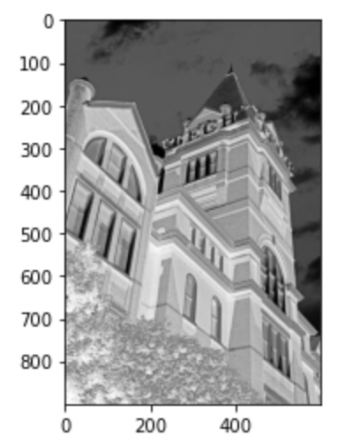
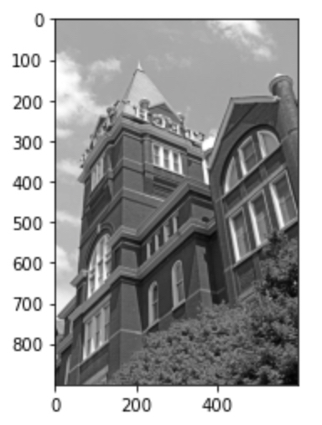
3.3 Display the negative image.
<Insert plot here>
3.4 Display the mirror image.
<Insert plot here>

Slide 8
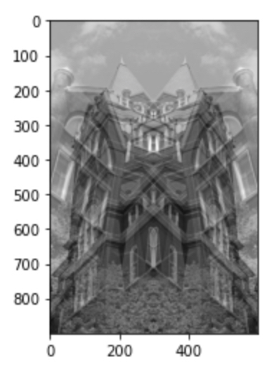
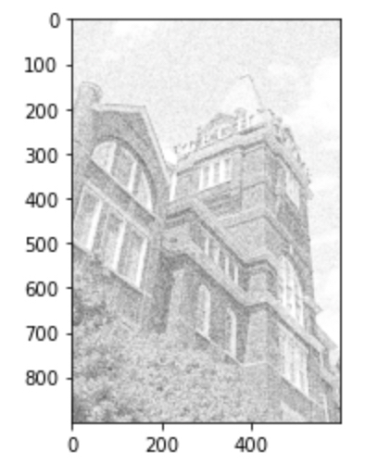
3.5 Display the averaged image.
<Insert plot here>
3.6. Display the clipped image.
<Insert plot here>

Slide 9
Understanding Color

Slide 10
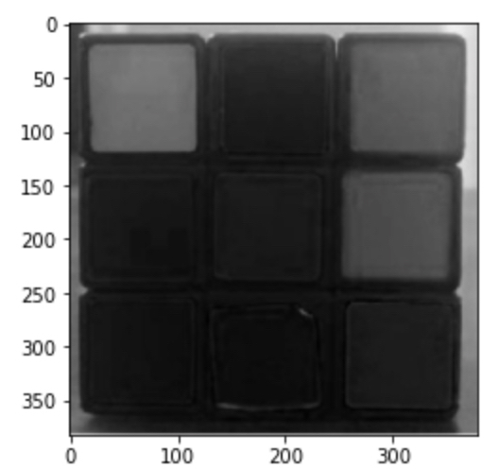
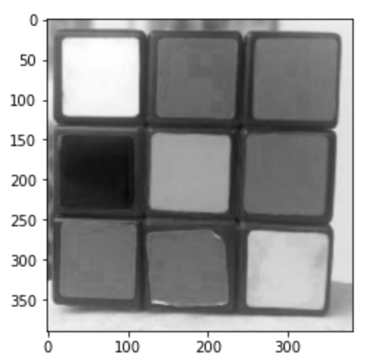
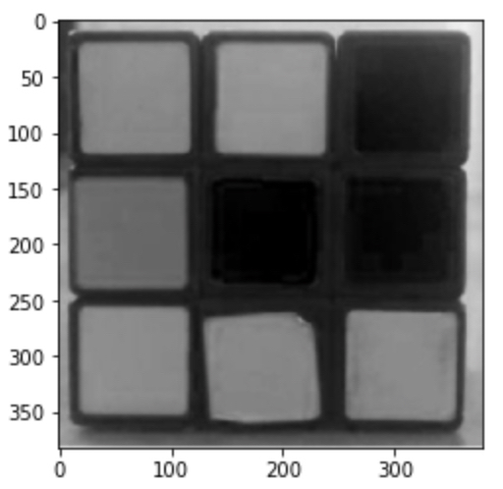
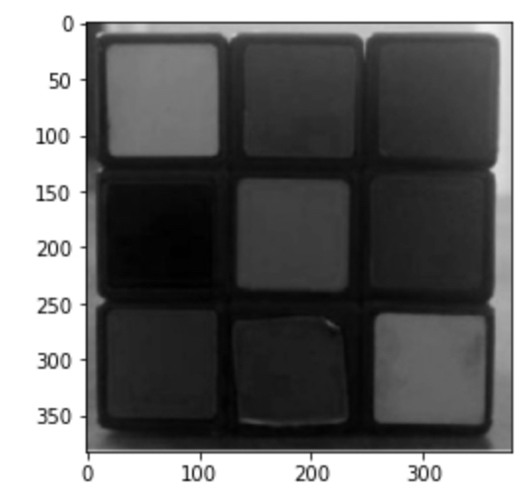
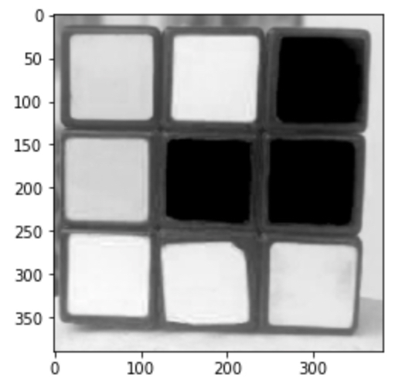
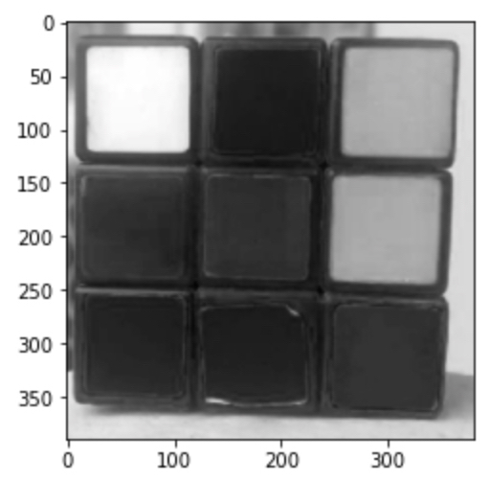
4.1. Load the images and plot their R, G, B channels separately as grayscale images using plt.imshow()(beware of normalization).
Indoor red
Indoor blue
Outdoor green
Indoor green
Outdoor red
Outdoor blue

Slide 11
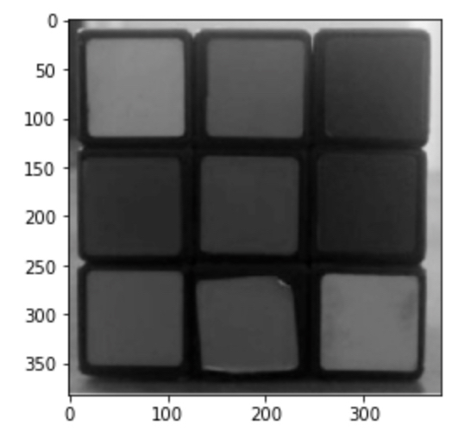
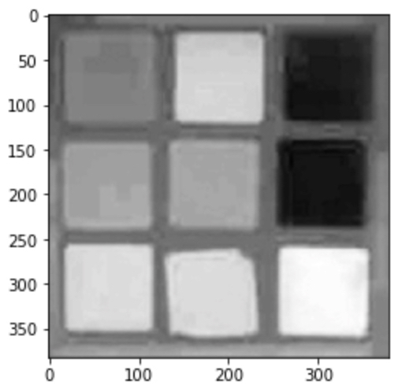
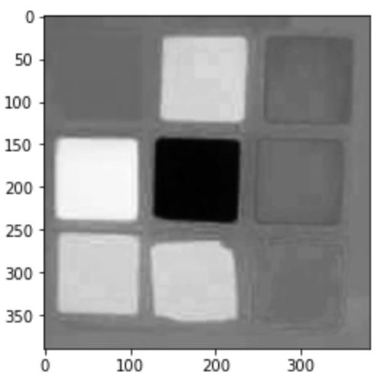
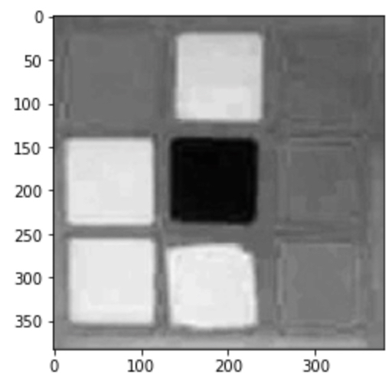
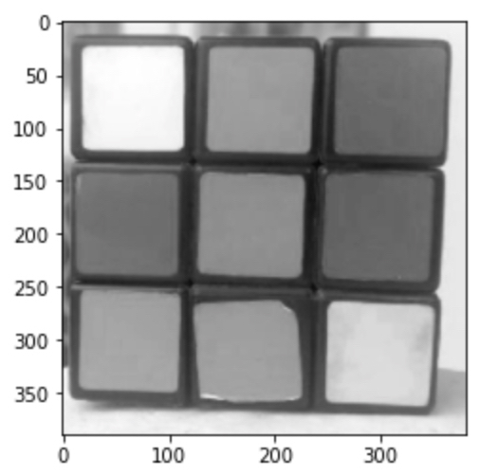
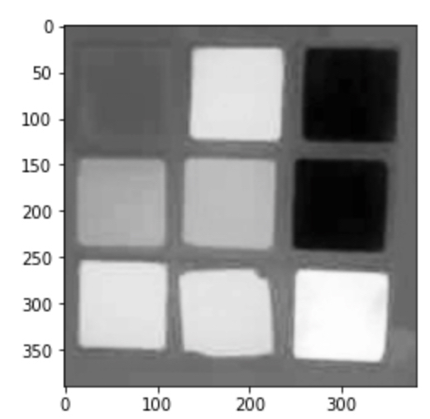
4.1.(contd) Then convert them into LAB color space using cv2.cvtColor()and plot the three channels again.
LAB indoor red
LAB indoor blue
LAB outdoor green
LAB indoor green
LAB outdoor red
LAB outdoor blue

Slide 12
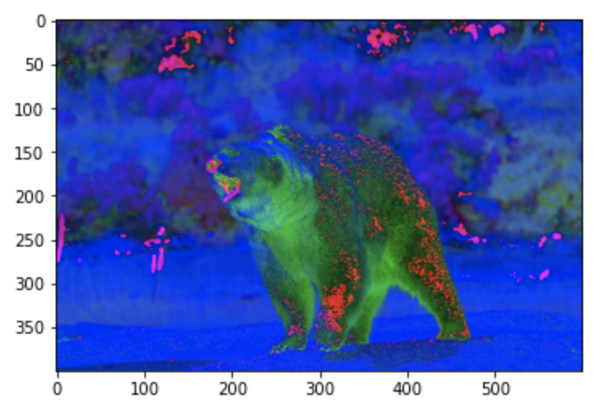
4.2. Convert the input image from RGB to HSV.

